Slide 1
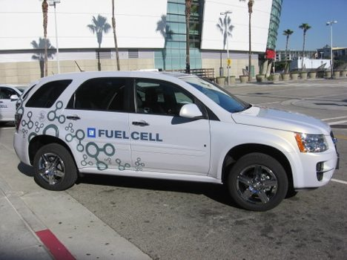
Optimized Catalyst Preparation for Polymer Electrolyte Membrane Fuel Cells
Anthony Adame
Advised by: Dr. A.M. Kannan
ASU/NASA Space Grant Program

Slide 2
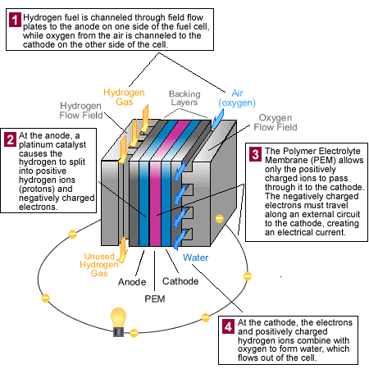
Polymer Electrolyte Membrane Fuel Cell
[1] Polymer Electrolyte Membrane Fuel Cell
ASU/NASA Space Grant Program

Slide 3
Uses of Fuel Cell
Automobiles
Grid Power
Homes
Hospitals
Hotels
Telecommunications
Water Treatment Plants
[2] GM Fuel Cell Equinox
ASU/NASA Space Grant Program

Slide 4
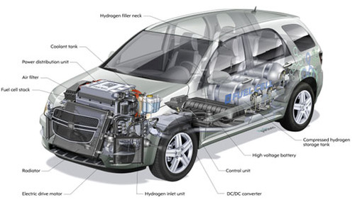
Fuel Cell Challenges
Cost
Platinum (Pt)
Hydrogen
Durability
Degradation of Pt
Degradation of GDL
Performance
[3] GM Fuel Cell Equinox Ghost Figure
ASU/NASA Space Grant Program

Slide 5
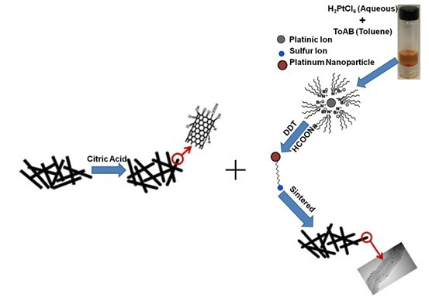
Two – Phase Transfer Method ( Dr. A.M Kannan and J.F. Lin of Arizona State University)
[4] Two-Phase Transfer Method courtesy of Dr. A.M Kannan and J.F. Lin
ASU/NASA Space Grant Program

Slide 6
Project Goals
Determine optimum sintering temperature of catalyst material
Determine optimum molar ratio of citric acid used to treat multi-walled carbon nanotubes (MWCNTs)
Determine optimum molar ratio of dodecanethiol (DDT) to Pt used to prepare catalyst material
ASU/NASA Space Grant Program

Slide 7
Experiments Conducted
Experiments 1-3
Sintering Temperature ( ° C ) (1.6 mMol citric acid, 8: 1 DDT ratio)
300
500
800
Experiments 3-5
Citric acid concentration (mMol) (8:1 DDT ratio, 800 °C sinter temp. )
1.6
0
3.2
Experiments 6 - 8
Molar Ratio of DDT to Pt (1.6 mMol citric acid, 800 °C sinter)
1: 1
2: 1
8: 1
ASU/NASA Space Grant Program

Slide 8
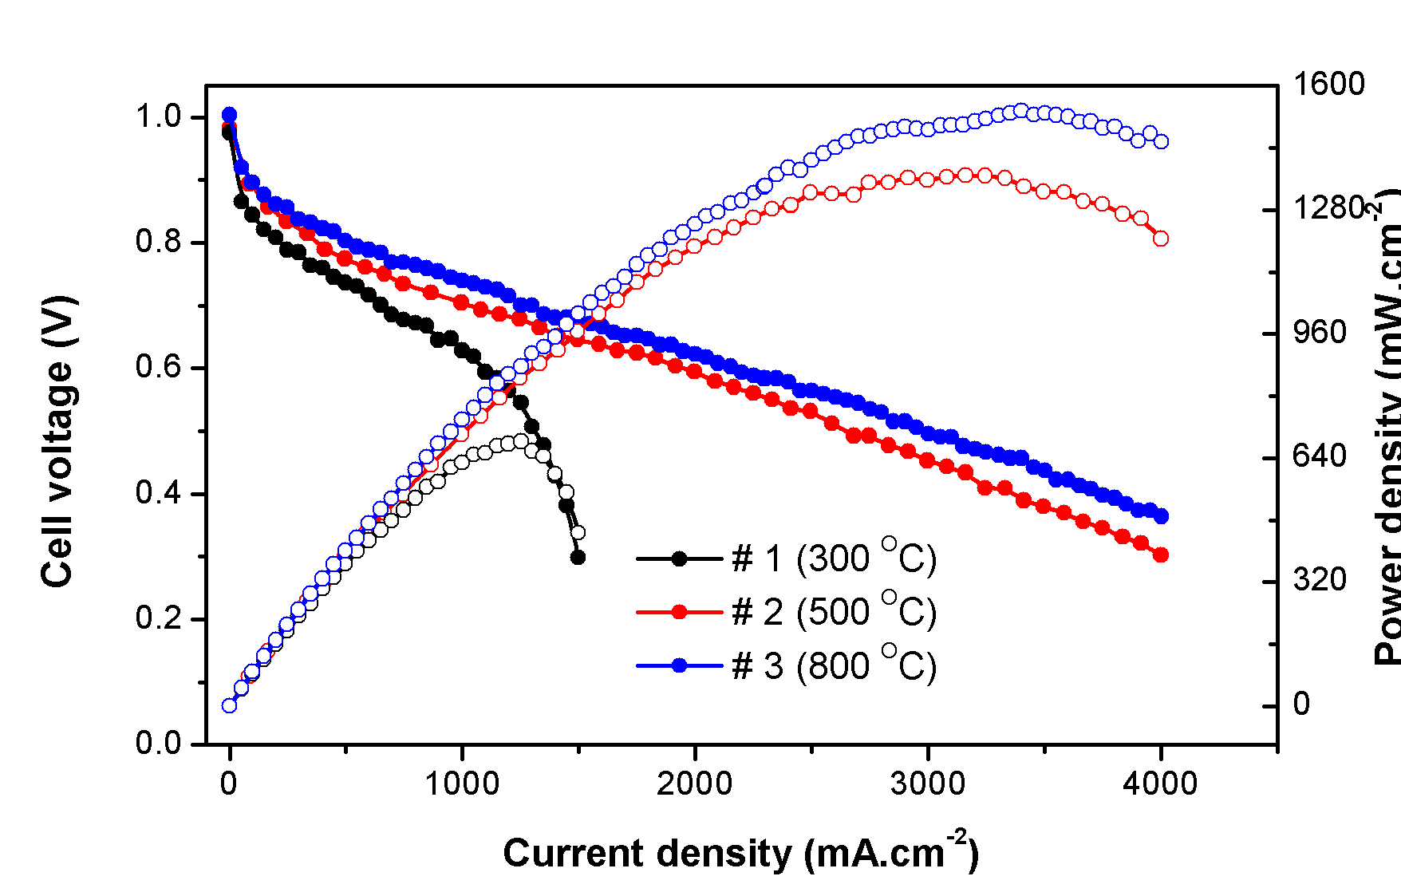
Performance Data – Sintering Temperature
[5] Performance data of sintering temperature experimentation
ASU/NASA Space Grant Program

Slide 9
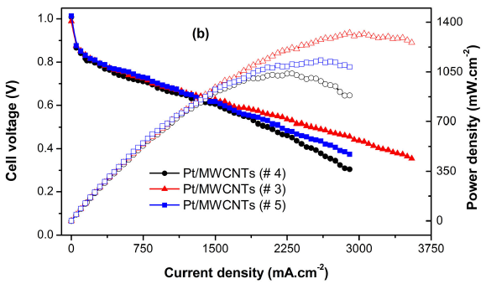
Performance Data – Citric Acid Concentration
[5] Performance data of citric acid concentration experimentation
ASU/NASA Space Grant Program

Slide 10
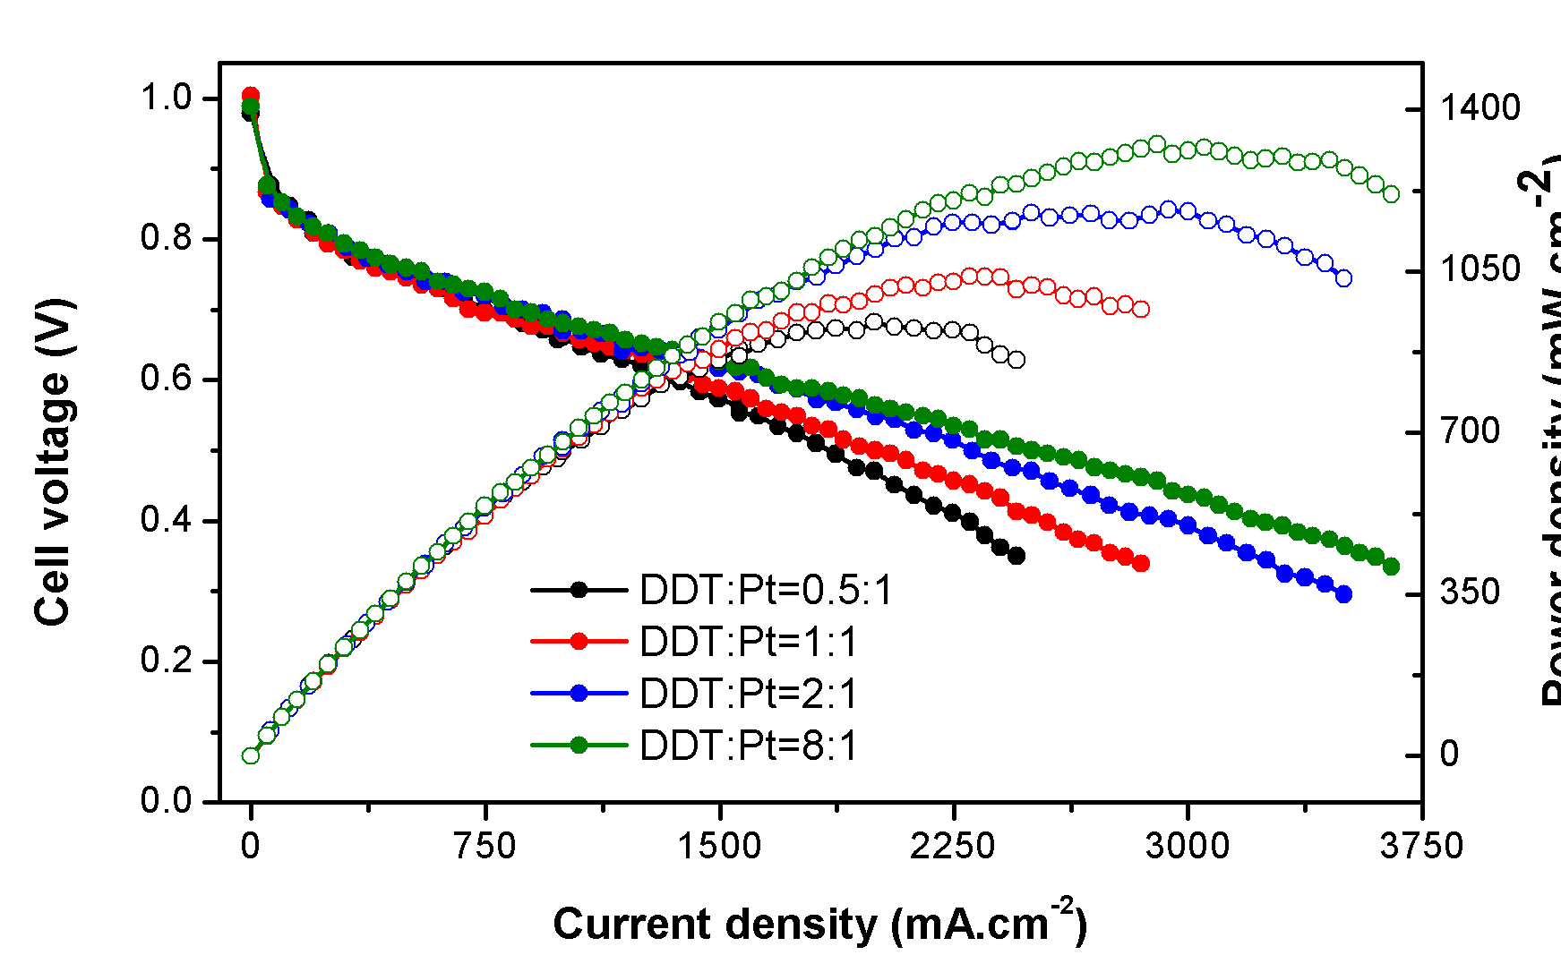
Performance Data – DDT to Pt Ratio
[5] Performance data of DDT to Pt Ratio experimentation
ASU/NASA Space Grant Program

Slide 11
Results
800° C is optimum sintering temperature for MWCNT supported catalyst material
Removes all thiol material → reduces resistance
Citric acid concentration of 1.6 mmol is optimum acid concentration for
functionalizing of MWCNTs
Lesser concentration does not form as many functionalized OH groups
Higher concentration damages MWCNT structure and degrades nanotubes into carbon material
DDT to Pt ratio of 8: 1 is the optimum ratio for MWCNT supported catalyst
material
ASU/NASA Space Grant Program

Slide 12
Outcomes
Project
Experimentation and Results Published – Journal of Electrochemical Society –
Accepted
New experimentation and results being conducted for future publication
Personal
Learned creative ways of thinking, how to conduct experiments, how to publish literature, and other priceless lessons from Jay Lin, my graduate mentor
Learned the importance of fuel cell technology and will conduct graduate research
on fuel cell technology under the advising of Dr. A.M. Kannan
ASU/NASA Space Grant Program

Slide 13
Acknowledgements
I would like to thank the following for their help and support throughout my experience with the AZ /NASA Space Grant Program:
Dr. A.M Kannan (Mentor)
Jay Lin (Graduate Mentor)
Chad Mason (Co-worker)
Rashida Villacorta
All fuel cell lab colleagues
Tom Sharp
Candace Jackson
Danielle Pies
Meg Hufford
AZ / NASA Space Grant
Arizona State University – Polytechnic Campus
University of Arizona
ASU/NASA Space Grant Program

Slide 14
References
[1] ] J.Hules and U. Wang, “ Scientists discover why the right amount of moisture in the membrane plays a key role in fuel cell efficiency,” in National Energy Research Scientific Computing Center, [online].
Available: http://www.nersc.gov/news/science/sandwich.php ]. Accessed: [Apr 12, 2010].
[2] National Hydrogen Association, “General Motors Equinox fuel cell,” Hydrogenassociation.org,
[online]. Available: http://www.hydrogenassociation.org/media/mediaDownload.asp
[Accessed: April 12, 2010].
[3] C. and S. Gable, “Chevrolet Equinox Fuel Cell Vehicle test drive,” About.com, [online].
Available: http://alternativefuels.about.com/od/fuelcellvehiclereviews/fr/equinoxfuelcell.htm,
[Accessed Apr. 12, 2010].
ASU/NASA Space Grant Program

Slide 15
References
[4] J.F. Lin, “Nano-Enabled Catalyst for High Power Proton Exchange Membrane Fuel Cells (PEMFCs),”
Thesis Presentation, Arizona State University, Apr. 4, 2010.
[5] J.F. Lin, A. Adame, and A.M. Kannan, “Development of durable platinum nanocatalyst on
carbon nanotubes for proton exchange membrane fuel cells,” in Journal of
Electrochemical Society - Accepted.
ASU/NASA Space Grant Program

